Slide 1
Topologies
Network topologies define how remote locations connect to each other and to the hub. The link over the satellite from the hub to the remote is called the outbound or downlink transmission, whereas the link from the remote to the hub is referred to as inbound or uplink. Satellite networks are primarily configured in one of these topologies:

Slide 2
Star (hub & spoke) Networks
In a star network topology, the hub connects to the remote, where all communications are passed back through the hub. Virtually an unlimited number of remotes can be connected to the hub in this topology. Smaller, lower powered BUCs can be used at the remote end since they are only connecting back to the larger hub antenna.

Slide 3
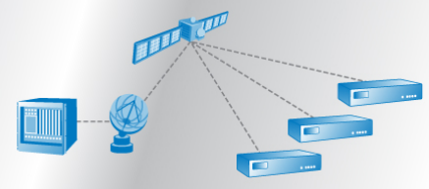
Figure 3. Star Topology

Slide 4
Mesh Networks
A mesh network topology allows one remote VSAT location to communicate with another remote location without routing through the hub. This type of connection minimizes delay and often is used for very high quality voice and video conferencing applications.
With this topology, larger antennas are required and more power is needed to transmit, thereby increasing cost.

Slide 5
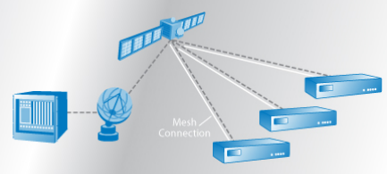
Figure 4. Mesh Topology

Slide 6
Hybrid Networks
A hybrid topology is a mix of star and mesh networking solutions. This topology allows the hub to send information to the remotes, with the remotes then able to communicate with other VSAT locations.

Slide 7
Point to Point Connectivity
Contrary to the networking topologies, a point-to-point topology involves a dedicated connection between two antennas. This topology is a direct pipeline with a set bandwidth capacity regardless of usage and is typically designed with Single Carrier per Channel (SCPC) technology.

Slide 8
Value Chain

Slide 9
Equipment Vendors
Equipment vendors are generally distinguished between pure antenna manufacturers and satellite equipment manufacturers that produce indoor or outdoor ground equipment including antennas, LNBs, BUCs, hubs, routers, software and network management systems.

Slide 10
Satellite Operators
Satellite operators are responsible for the planning and cost of the construction and launch of satellite into space. They own and manage a constellation of satellites and determine coverage and geographic areas. Satellite operators lease this bandwidth to service providers, government entities, television broadcasters, enterprises and sometimes direct to the end consumer.

Slide 11
Service Providers/ Network Operators
providers, sometimes known as network operators, are telecommunication companies or specialized satellite service companies who sell a full service package to the end customer. They lease capacity from satellite operators, purchase and operate the network equipment and the antenna, and are responsible for the installation and maintenance of the network.

Slide 12
Customers
Customers are the enterprises, organizations and consumers who use satellite communication services. Governments or large corporate customers may operate as their own service provider by managing the equipment directly and leasing bandwidth from satellite operators. Individuals and smaller enterprises typically work with service providers who manage the equipment and connections.

Slide 13
Applications
Always-on, high-speed connectivity is needed for a variety of applications. Whether broadcasting radio to consumers or multi-casting data for enterprise networks, satellite can support all of a user’s networking requirements.

